Slide 1
Team Blue: Distance

Slide 2
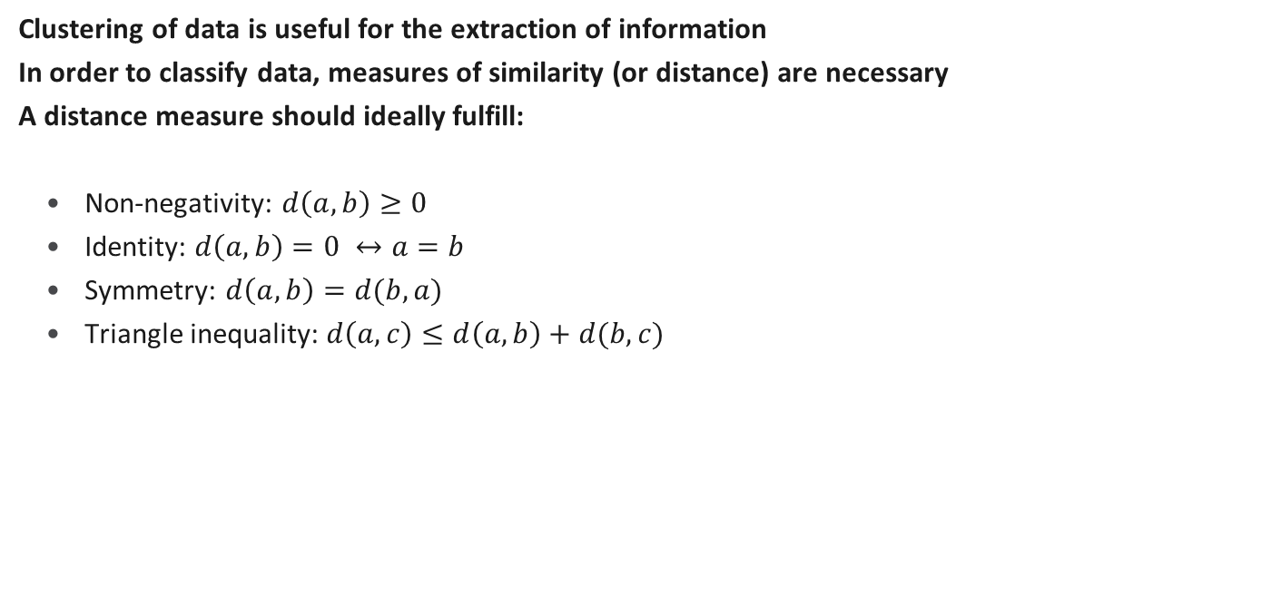
A motivation for distance measures
Clustering of data is useful for the extraction of information
In order to classify data, measures of similarity (or distance) are necessary
A distance measure should ideally fulfill:
Non-negativity: $d\left(a,b\right)≥0$
Identity: $d\left(a,b\right)=0 ↔a=b$
Symmetry: $d\left(a,b\right)=d(b,a)$
Triangle inequality: $d\left(a,c\right)≤d\left(a,b\right)+d(b,c)$

Slide 3
Euclidean Distance

Slide 4
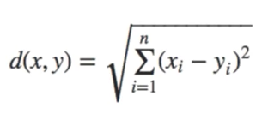
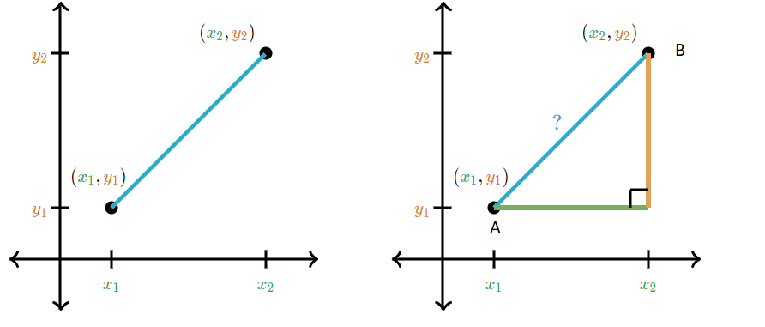
Euclidean distance
Property:
It is a straight-line distance between two point, similar to using a ruler to actually measure the distance
A generalized term for the Euclidean norm is the L2 norm
Drawbacks:
Not a good metric in high dimensions
in high dimensional data, some variables are likely to be correlated, often highly correlated and Euclidean distance does not deal well with this.
due to the squared terms, is particular sensitive to noise
Euclidean distance is the only metric that is the same in all direction, that is, rotation invariant.
Formula:

Slide 5
Cosine Similarity

Slide 6
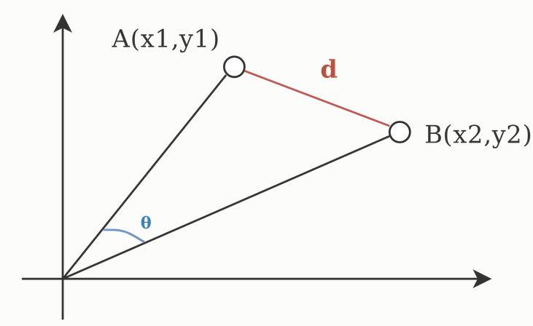
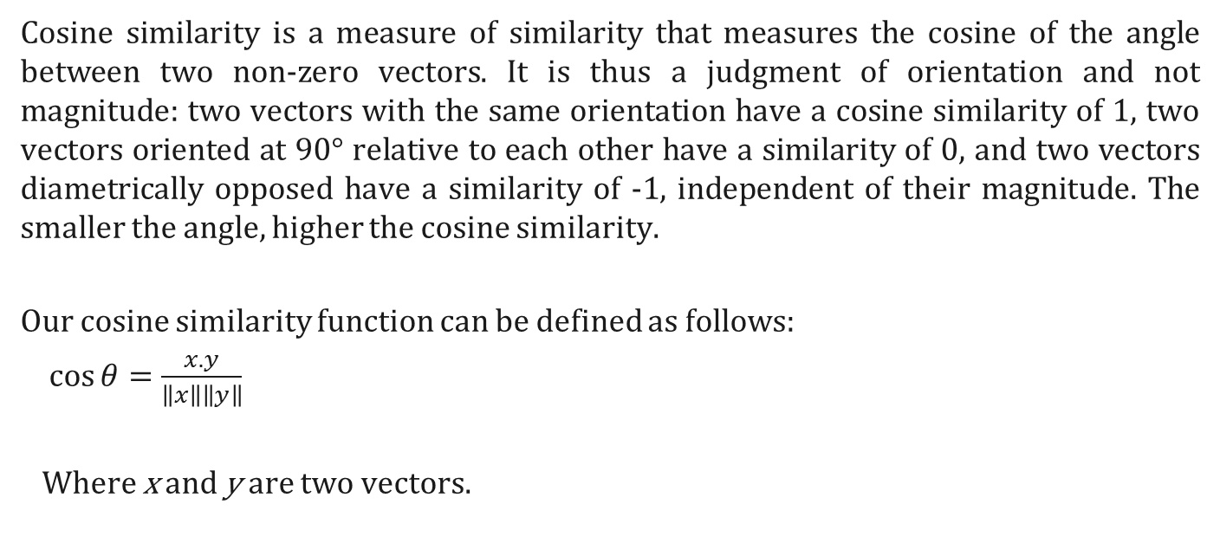
Cosine Similarity
Cosine similarity is a measure of similarity that measures the cosine of the angle between two non-zero vectors. It is thus a judgment of orientation and not magnitude: two vectors with the same orientation have a cosine similarity of 1, two vectors oriented at 90° relative to each other have a similarity of 0, and two vectors diametrically opposed have a similarity of -1, independent of their magnitude. The smaller the angle, higher the cosine similarity.
Our cosine similarity function can be defined as follows:
$\cos{θ}=\frac{x.y}{\left\|x\right\|\left\|y\right\|}$
Where x and y are two vectors.

Slide 7
Use case or product or framework
The cosine similarity is most used in:
high-dimensional positive spaces
for measuring distance when the magnitude of the vectors does not matter
For example in:
information retrieval
text mining or working with text data represented by word counts
each term is notionally assigned a different dimension and a document is characterized by a vector where the value in each dimension corresponds to the number of times the term appears in the document. Cosine similarity then gives a useful measure of how similar two documents are likely to be in terms of their subject matter.
Source: XXX

Slide 8
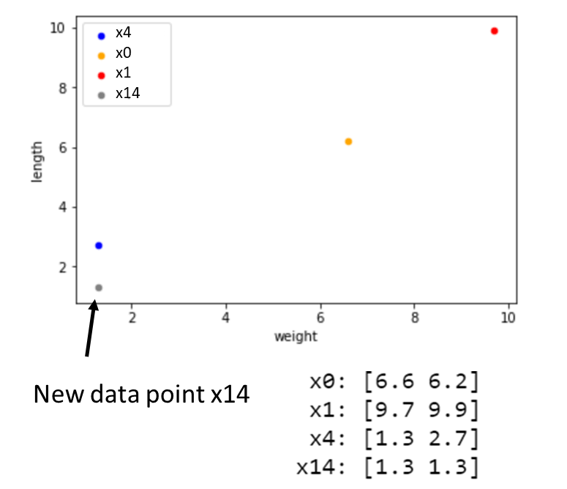
Comparing Euclidean and Cosine
According to euclidean distance:
→ instance #14 is closest to #4
According to cosine similarity
→ instance #14 is closest to #1

Slide 9
Jaccard Similarity Index

Slide 10
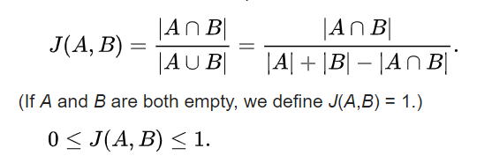
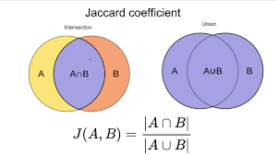
Jaccard Similarity Index

Slide 11
Jaccard Similarity Index
Used for comparing similarity, dissimilarity, and distance of the data set.
Only measures the similarity between finite sample sets.
Use Case:
used for recommendation for similar items.
Can be use for information retrieval
Issues:
Doesn’t consider term frequency

Slide 12
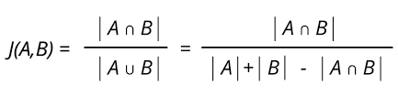
Jaccard Similarity
Example: Set A = {apple, banana, grapes} Set B = {apple, banana, cherry, pineapple}
Jaccard Distance:
Jaccard distance, is a measure of how dissimilar two sets are.
1 – 0.4 = 0.6
= 2
3 + 4 - 2
Apple
Banana
Cherry
Pineapple
Grapes
= 0.4 or 40% Similar

Slide 13
Mahalanobis distance

Slide 14
Problems with Euclidean distance
Euclidean distance is the distance between two points
Scaling of variables will affect distance
If dimensions of the data are correlated, Euclidean distance does not yield information about closeness to the cluster (problem of non-spherical distributions)

Slide 15

Mahalanobis distance is a measure of the distance between a point P and a distribution D
Mahalanobis distance is given by
$$D^{2}={\left(x−μ\right)}^{T}C^{−1}(x−μ)$$
Similar to z-Score transformation, the distance from the observation to the location parameter is divided by the sample covariance
Usecases
Outlier detection
Classification
One-class classification
Drawbacks
Needs grouped/ labelled data
Inverse of covariance matrix needed

Slide 16
Nearest k neighbors-manifold based: Isomap

Slide 17
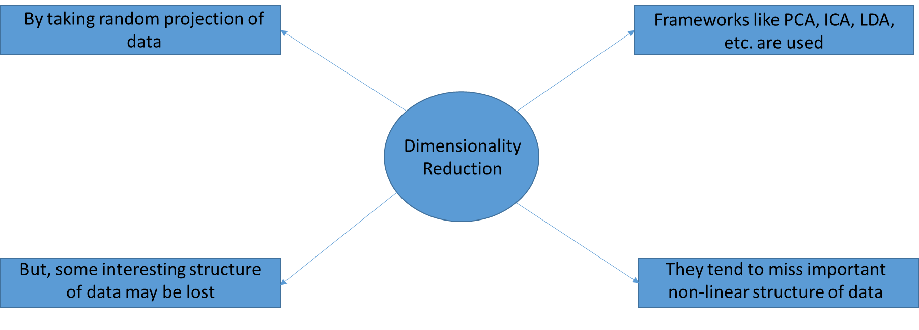
to visualize the structure of data set

Slide 18
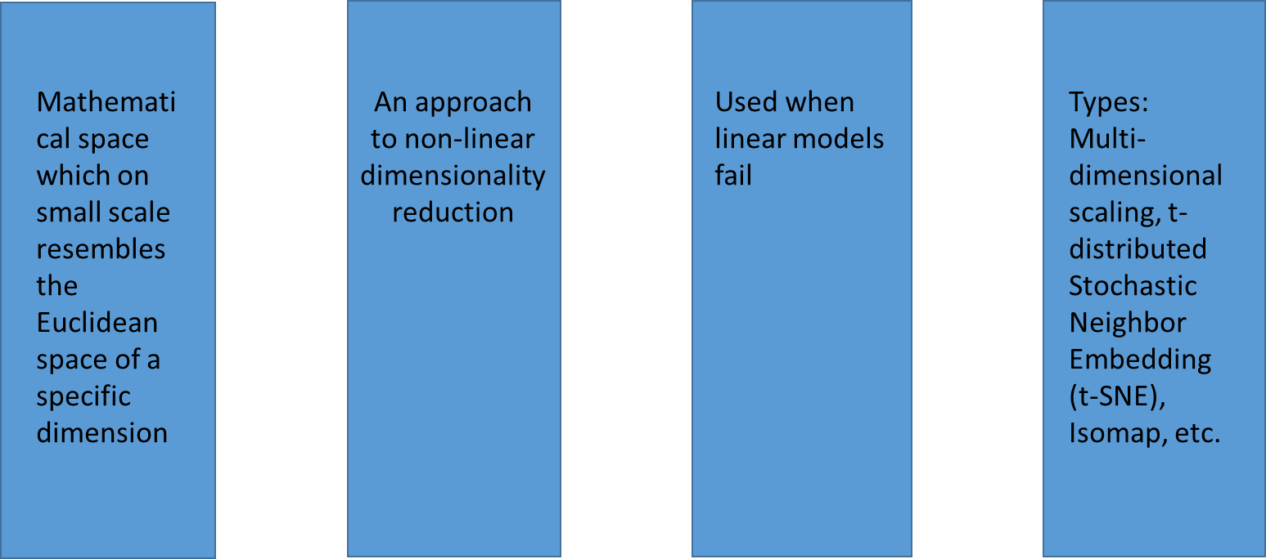
Manifold based dimensionality reduction tools

Slide 19
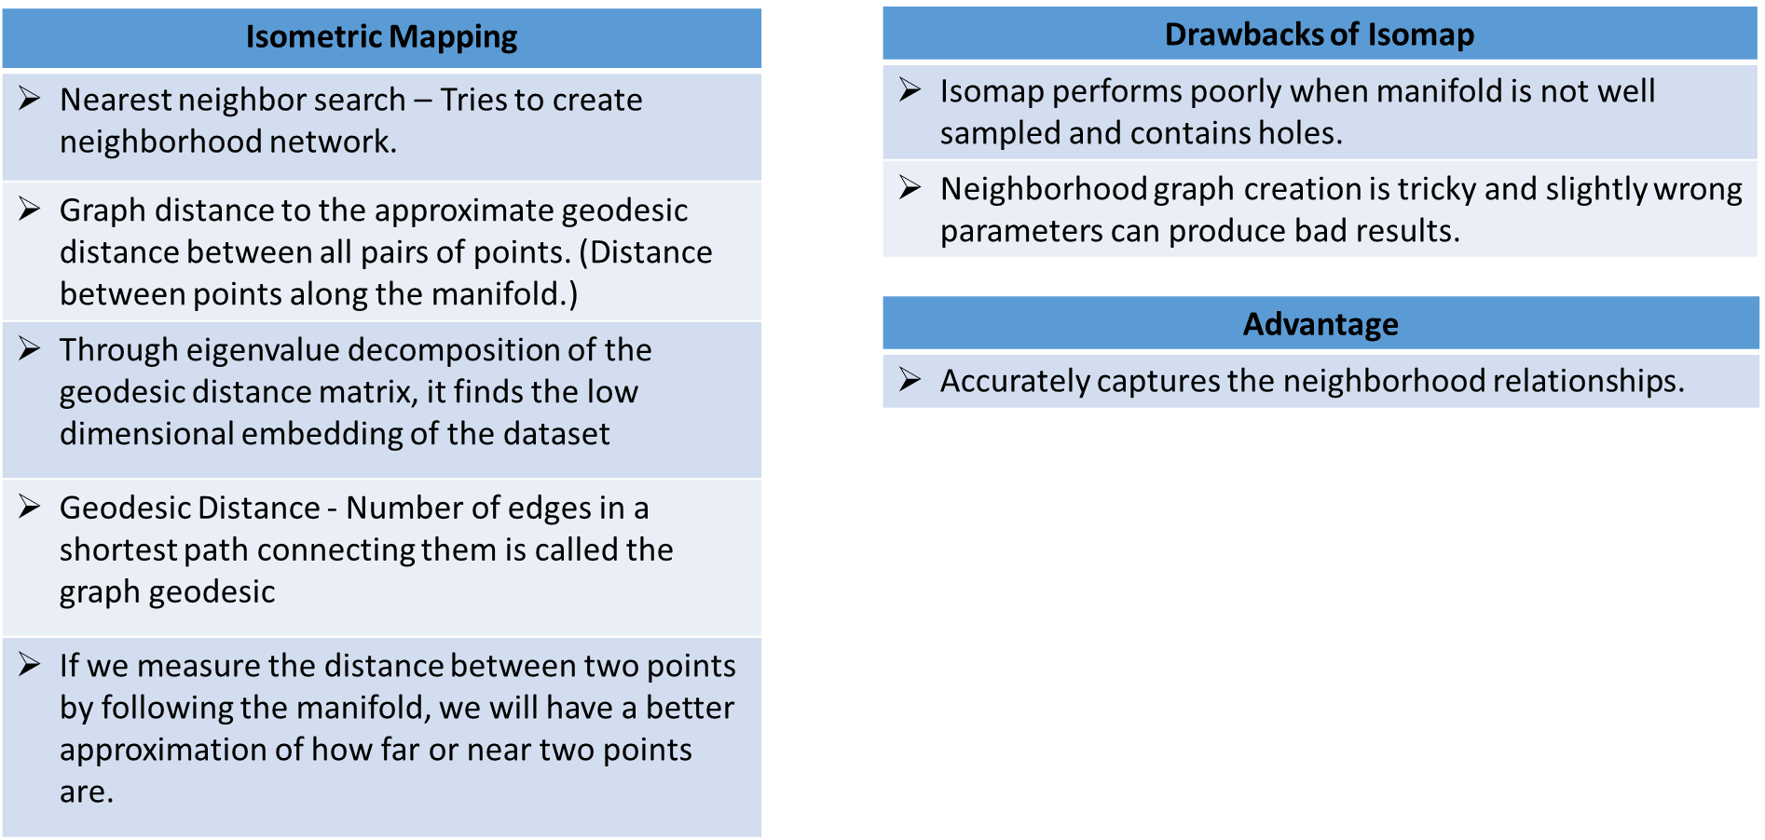
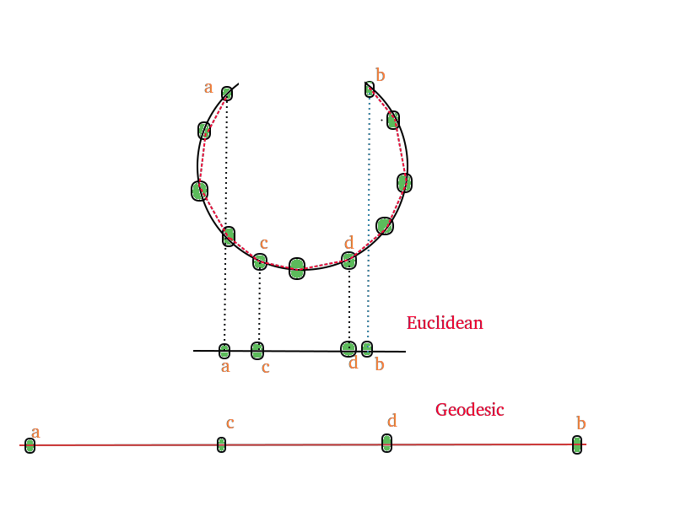
Isomap

Slide 20
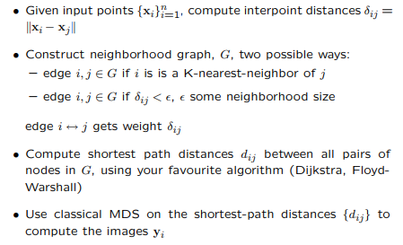
Isomap Algorithm
Reference: http://www.cs.toronto.edu/~dross/411/16mds-4up.pdf

Slide 21
Thank you

